Slide 1
OPERATING SYSTEMS
Module3_Part5
Textbook : Operating Systems Concepts by Silberschatz

Slide 2
Producer consumer problem using semaphores
🠶 we present a general structure of this scheme without committing ourselves to any particular implementation;
🠶 We assume that the pool consists of n buffers, each capable of holding one item. The mutex semaphore provides mutual exclusion for accesses to the buffer pool and is initialized to the value 1.
The empty and full semaphores count the number of empty and full buffers. The semaphore empty is initialized to the value n; the semaphore full is initialized to the value 0.

Slide 3
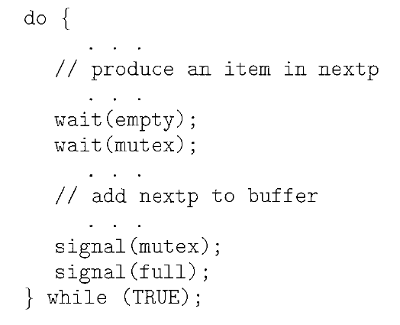
Producer consumer problem using semaphores

Slide 4
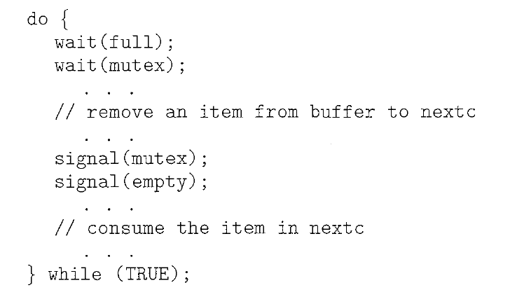
Producer consumer problem using semaphores
We can interpret this code as the producer producing full buffers for the consumer or as the consumer producing empty buffers for the producer.

Slide 5
The Readers-Writers Problem
🠶 Suppose that a database is to be shared among several concurrent processes.
🠶 Some of these processes may want only to read the database, whereas others
may want to update (that is, to read and write) the database.
🠶 the former is called readers and to the latter called writers.
🠶 if two readers access the shared data simultaneously, no adverse effects will result.
🠶 However, if a writer and some other process (either a reader or a writer) access the database simultaneously, chaos may ensue.
🠶 To ensure that these difficulties do not arise, we require that the writers have exclusive access to the shared database while writing to the database.
🠶 no reader be kept waiting unless a writer has already obtained permission to use the shared
object.

Slide 6
Solution to readers writers problem
🠶 In the solution to the first readers-writers problem, the reader processes share the following data structures:
semaphore mutex, wrt;
int readcount;
🠶 The semaphores mutex and wrt are initialized to 1; readcount is initializedto 0.
🠶 The semaphore wrt is common to both reader and writer processes.
🠶 The mutex semaphore is used to ensure mutual exclusion when the variable readcount is
updated.
🠶 The readcount variable keeps track of how many processes are currently reading the object.
🠶 The semaphore wrt functions as a mutual-exclusion semaphore for the writers.
🠶 It is also used by the first or last reader that enters or exits the critical section.
🠶 It is not used by readers who enter or exit while other readers are in their critical sections.

Slide 7
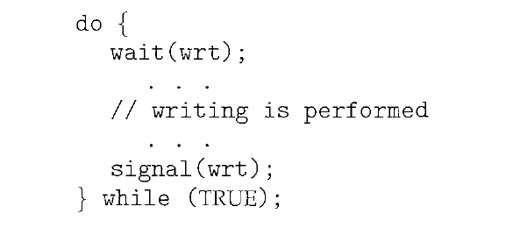
The Readers-Writers Problem solution
typedef int semaphore; semaphore mutex=1; semaphore wrt=1;
int readcount=0;
Structure of a writer

Slide 8
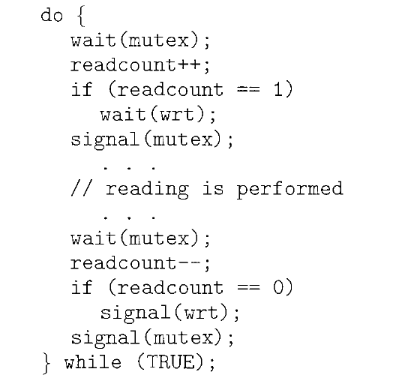
Solution--The Readers-Writers Problem
//gain access to readcount
//increment readcount
//if this is the first process to read db
//prevent writer process to access db
//allow other process to access readcount
//gain access to readcount
//decrement readcounter
//this is the last process to read db
//leave control of db,allow writer process
//allow other process to access readcount
Structure of a reader

